Slide 1
Cal/OSHA Avian Influenza (Bird Flu) & Worker Protection Select requirements Title 8 Section 5199.1 Aerosol Transmissible Diseases – Zoonotic

Slide 2
Cal/OSHA
Cal/OSHA protects the health and safety of all workers in California by:
Creating and enforcing safety and health regulations for workers
Providing outreach, education, and assistance
Cal/OSHA protects all workers in California regardless of immigration status
Cal/OSHA does not ask about a worker's immigration status
Cal/OSHA does not enforce immigration laws and will not report anyone to US Immigrations and Customs Enforcement (ICE)

Slide 3
Title 8 Section 5199.1
Aerosol Transmissible Disease – Zoonotic
5199.1 is the law that protects workers from diseases that:
Come from animals (zoonotic), and
Can infect persons through splashes or through the air (aerosol)
The law applies in most workplaces where there are animals or unprocessed animal products, such as:
Animal farms, dairies, slaughterhouses, zoos, veterinary clinics, jobs that handle wildlife, etc.

Slide 4
Base Requirements of 5199.1
Requirements for employers:
Have written instructions and rules for protecting employees from diseases that come from animals
Instructions and rules must include sanitation, illness investigation, training, biosecurity, and use of personal protective equipment (PPE)
Employer must provide employee training that covers these topics
Employer must maintain records of how they comply with the law

Slide 5
Additional Requirements of 5199.1
Additional requirements for dairies and animal farms with:
5199.1(c): USDA or CDFA quarantine order, movement restrictions, or infection control order
and
5199.1(d): Infected animals & wastes, and areas used to contain infected animals and wastes
Part (c) can apply even if there are no infected animals
Both requirements (c) and (d) apply to cattle herds, poultry farms, and any other farms/ranches with infected animals

Slide 6
Requirements – USDA or CDFA quarantine or infection control order
Even if there are no infected animals
Employers must:
Have detailed written instructions and rules on how to work safely
Set up restricted areas where exposure to animal diseases could occur
Post signs at all entrances to restricted areas. Signs must:
Identify areas as restricted areas
Be in all languages spoken by workers
5199.1(c)

Slide 7
Requirements – USDA or CDFA quarantine or infection control order
Even if there are no infected animals
In restricted areas
A supervisor knowledgeable in the dairy’s written safety instructions and rules must oversee employees in restricted areas
In restricted areas, the employer must provide and ensure use of personal protective equipment and clothing (PPE):
Full-body coveralls, head coverings, gloves, mouth/nose protection, rubber boots
Eye protection
Respirators indoors or other enclosed areas where there are potentially infectious aerosols (splashes, droplets, mists, dust, tiny particles, etc.)
The employer must provide and ensure access to change rooms, shower rooms, restrooms, and drinking water
5199.1(c)

Slide 8
Requirements – USDA or CDFA quarantine or infection control order
Even if there are no infected animals
In restricted areas:
Employers must provide employees who enter these areas with:
Medical services, health checks, vaccinations, medications – as recommended by CDC, CDPH, or Local Health Officer
Training – animal disease hazards, protective measures, PPE, respirators, decontamination, medical services, health checks, vaccinations, medications
Training must be appropriate for employees’ level of education, literacy, and language
5199.1(c)

Slide 9
5199.1(d) Handling infected animals
And cleaning and disinfecting areas that contained infected animals or wastes
More protective & detailed than 5199(c)
Applies to:
Handling, culling, transporting, killing, eradicating, or disposing of infected animals
Cleaning & disinfecting of areas used, or previously used, to contain infected animals and their wastes
Cattle herds/dairies & poultry farms with infected animals
5199.1(d)

Slide 10
Handling infected animals
And cleaning and disinfecting areas that contained infected animals or wastes
Written Safety Plan. Employers must:
Have written safety instructions and rules
Make available to employees onsite
Have a Workplan that includes:
Risk assessment for biological, chemical, physical, and safety hazards
Description of protective measures
Designate restricted areas
List all jobs, tasks with employee exposure
5199.1(d)

Slide 11
Handling infected animals
And cleaning and disinfecting areas that contained infected animals or wastes
Written instructions – methods to protect employees:
Protective measures (engineering controls, work practice controls)
Instructions and rules for safe handling of hazardous chemicals
Respiratory protection
Personal protective equipment and clothing (PPE)
Decontamination instructions and rules
5199.1(d)

Slide 12
Handling infected animals
And cleaning and disinfecting areas that contained infected animals or wastes
Written instructions – methods to protect employees:
Disposal of animal waste and contaminated PPE
Medical services
Training
Recordkeeping
5199.1(d)

Slide 13
Handling infected animals
And cleaning and disinfecting areas that contained infected animals or wastes
Supervision:
Person knowledgeable of employer's safety instructions and rules must supervise and enforce rules in the restricted area
Ensure only trained persons enter restricted area
Record name, entry time, and exit time for each person who enters and/or exits restricted area
Ensure correct PPE and respirators are used
5199.1(d)

Slide 14
Handling infected animals
And cleaning and disinfecting areas that contained infected animals or wastes
Respiratory protection:
Required in restricted areas
Enclosed areas: Use elastomeric (rubbery) respirators or powered air purifying respirators (PAPRs)
Outdoors: Use N95 or better respirator
5199.1(d)

Slide 15
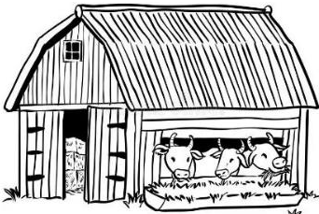
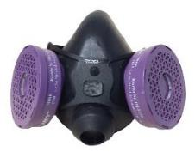
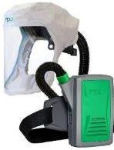
Handling infected animals
And cleaning and disinfecting areas that contained infected animals or wastes
Respiratory Protection:
Respirators for enclosed areas – Use elastomeric or PAPR
5199.1(d)

Slide 16
Handling infected animals
And cleaning and disinfecting areas that contained infected animals or wastes
Respiratory Protection:
Enclosed areas – Exception: N95s are okay if employer can show through objective evidence that better respirators are not needed to protect employees
5199.1(d)

Slide 17
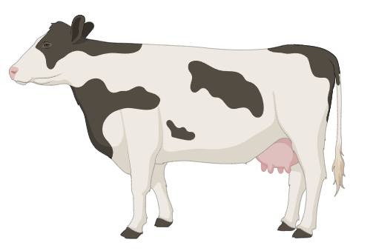
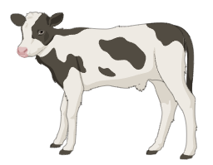
Handling infected animals
And cleaning and disinfecting areas that contained infected animals or wastes
Respiratory Protection:
Use N95s or better outdoors
5199.1(d)

Slide 18
Handling infected animals
And cleaning and disinfecting areas that contained infected animals or wastes
Decontamination:
Employers must ensure:
Employees properly decontaminate when leaving restricted areas
Contaminated clothing and equipment are decontaminated or disposed of
Decontamination facilities must include change rooms and shower facilities
5199.1(d)

Slide 19
Handling infected animals
And cleaning and disinfecting areas that contained infected animals or wastes
Medical Services:
Employers must have a medical services program for employees who enter restricted areas:
Employers must consult with a physician or other licensed healthcare professional (PLHCP) knowledgeable about animal disease and chemical hazards
The program must maintain medical confidentiality
5199.1(d)

Slide 20
Handling infected animals
And cleaning and disinfecting areas that contained infected animals or wastes
Additional medical services:
For each employee, employer must provide:
Initial medical evaluation prior to entry into restricted area
All vaccinations, medications, and health checks recommended by PLHCP, CDC, CDPH, or local health officer
Follow-up medical evaluations as recommended by PLHCP, CDC, CDPH, or local health officer
5199.1(d)

Slide 21
Handling infected animals
And cleaning and disinfecting areas that contained infected animals or wastes
Additional Medical Services:
PLHCP (doctor/nurse) prepares written report to employer for each employee with only:
Respirator medical evaluation
Whether employee received exams, vaccines, and/or medicines
Authorization for employee to work in restricted area
5199.1(d)

Slide 22
Handling infected animals
And cleaning and disinfecting areas that contained infected animals or wastes
Training:
When to provide:
Upon Initial assignment
When site conditions change substantially
When new hazards are introduced or recognized
Must be appropriate for employees’ level of education, literacy, and language
5199.1(d)

Slide 23
Handling infected animals
And cleaning and disinfecting areas that contained infected animals or wastes
Training Content:
Identification, description, signs, and symptoms of animal diseases
Instructions and rules for working restricted areas and when handling infected animals and their waste
5199.1(d)

Slide 24
Handling infected animals
And cleaning and disinfecting areas that contained infected animals or wastes
Training Content (continued):
Employer's safety program:
Control measures
Use of respiratory protection and PPE
Cleaning and decontamination instructions
5199.1(d)

Slide 25
Handling infected animals
And cleaning and disinfecting areas that contained infected animals or wastes
Training Content (continued):
Access to sanitation facilities and drinking water
Meaning of signs
Hazard communications – chemicals
Employer’s medical services program
5199.1(d)

Slide 26
Resources
Cal/OSHA Guidance on Avian Flu
Protection from avian influenza webpage with info for employers and workers: www.dir.ca.gov/dosh/avian-flu/

Slide 27
Resources
Cal/OSHA Guidance on Avian Flu
Workplace safety and health guide on zoonotic aerosol transmissible disease standard: www.dir.ca.gov/dosh/dosh_publications/Zoonotic-ATD-Hazards.pdf

Slide 28
Resources
Cal/OSHA Guidance on Avian Flu
Model injury and illness prevention program to address zoonotic hazards for employers: www.dir.ca.gov/dosh/dosh_publications/Model-IIPP-Zoonotic.docx

Slide 29
Cal/OSHA Consultation Services
Free for employers
No fines, penalties, or citations issued
Consultation does not share with Cal/OSHA Enforcement
The consultation is confidential
Employer receives a written report summarizing the consultation evaluation
The written report is not a citation
More information: Call 1-800-963-9424 or visit us online at www.dir.ca.gov/dosh/consultation.html

Slide 30
Workers’ Compensation
Employers must provide workers’ compensation benefits for workers who get bird flu on the job
Unlikely to get bird flu from another person
Employees exposed to animals on the job can likely prove that their illness is from work, unless they were exposed to bird flu away from work
Workers’ compensation benefits include:
Medical Care – employer pays all reasonable and necessary treatment
Temporary Disability Benefits – employer pays portion of lost wages if employee misses 3 or more days of work because of the illness
Permanent disability benefits – if illness causes permanent impairment

Slide 31
Workers’ Compensation
For more information:
Division of Worker Compensation: 1-800-736-7401
FAQs: https://www.dir.ca.gov/dwc/DWC_FAQ.htm (in English and Spanish)

Slide 32
Paid Sick Leave
Employers are required to provide paid sick leave
Employers must allow an employee to use up to 40 hours or five days, whichever is more, of earned paid sick leave in a 12-month period
To qualify for paid sick leave, employees must:
Work at least 30 days for the same employer in a year
Work a total of 90 days for the same employer
More information: https://www.dir.ca.gov/dlse/California-Paid-Sick-Leave.html (available in English and Spanish)

