Slide 1


La Migra is at the Door! What Do I Do?
Immigration-Related Enforcement
Agencies, and Best Practices
Rebecca Hause-Schultz
Partner | Fisher Phillips
rhause-schultz@fisherphillips.com
Brian Little
FELS and California Farm Bureau
blittle@CFBF.com

Slide 2
What is Happening?
Since President Donald Trump resumed office on January 20, 2025, his administration has intensified immigration enforcement, particularly through increased U.S. Immigration and Customs Enforcement (ICE) raids. Key developments include:
  Nationwide Enforcement Operations: On January 26, 2025, the administration launched a comprehensive immigration enforcement operation involving multiple federal agencies. This initiative led to numerous arrests across various cities.
  Policy Changes: The administration has rolled back previous directives that limited immigration enforcement in sensitive areas such as hospitals, places of worship, and schools, thereby broadening the scope of potential enforcement actions.
  Economic and Social Impacts: These operations have impacted businesses reliant on immigrant labor.
Notes:
https://www.kget.com/news/local-news/us-cbp-issues-statement-on-ongoing-operation-return-to-sender-in-bakersfield-area/

Slide 3
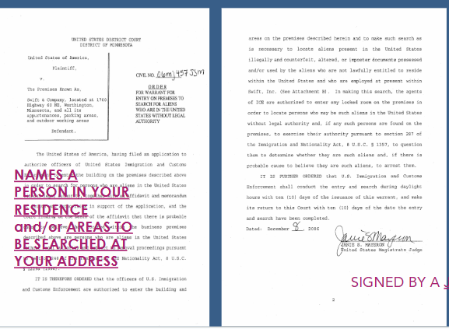
What protections are available?
Senate Bill 54 – “California Values Act” (effective Jan 1, 2018)
  Bars local law enforcement from assisting Federal Immigration Enforcement
  There are exceptions (i.e., individual has a criminal record)
Employers and employees have rights under law, regardless
of status
  4th Amendment – protects people against unreasonable
  search and seizure of their home, person and belongings
  5th Amendment – right to remain silent
Worksite Raids must be accompanied by a Judicial Warrant
signed by a judge and give a specific scope of search
and seizure.
https://www.nilc.org/resources/a-guide-for-employers-what-to-do-if-immigration-comes-to-your-workplace/
Notes:
https://www.kget.com/news/local-news/us-cbp-issues-statement-on-ongoing-operation-return-to-sender-in-bakersfield-area/

Slide 4
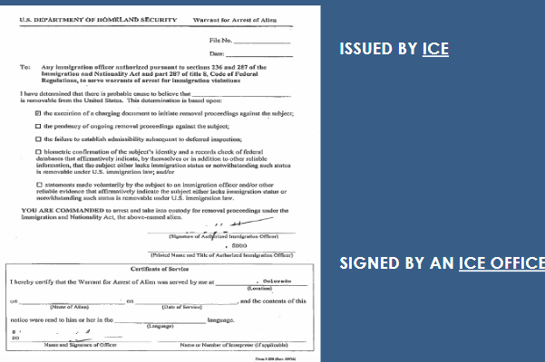
Individual Rights
  4th Amendment Magic Words: Am I free to go?
  If yes, walk away calmly. If no, detained.
  Can only detain if they have reasonable suspicion
  (don’t give any info that could lead to discriminatory
  suspicion (i.e. birth country)
  5th Amendment Magic Words: I want to remain silent
  CA does not have a “stop and identify” law
  An administrative warrant authorizes an ICE agent to make an arrest or seizure, but not to search
  An ICE warrant does not authorize an ICE agent to enter a private space or home without consent
  An ICE warrant does not provide probable cause of a crime or meet Fourth Amendment requirements for arrest
Notes:
https://www.kget.com/news/local-news/us-cbp-issues-statement-on-ongoing-operation-return-to-sender-in-bakersfield-area/

Slide 5
Resources
Know Your Rights
https://www.aclusocal.org/en/know-your-rights
Know your rights when stopped
https://www.aclusocal.org/en/know-your-rights/when-stopped-officer
https://www.aclusocal.org/es/know-your-rights/si-lo-detiene-un-oficial
Know your rights if questions by police, FBI, customs agents or immigration officers
https://www.aclusocal.org/en/know-your-rights/if-questioned-police-fbi-customs-agents-or-immigration-officers
https://www.aclusocal.org/es/know-your-rights/que-debe-hacer-si-la-policia-un-agente-de-immigracion-o-el-fbi-lo-detiene
Know your rights when stopped by federal agents
https://www.aclusocal.org/en/know-your-rights/when-stopped-federal-agents
https://www.aclusocal.org/es/know-your-rights/si-lo-detiene-un-agente-federal
Notes:
https://www.kget.com/news/local-news/us-cbp-issues-statement-on-ongoing-operation-return-to-sender-in-bakersfield-area/

Slide 6
ICE Raid vs. ICE Audit
ICE Raid
  A surprise enforcement action where U.S. Immigration and Customs Enforcement (ICE) agents enter a workplace, home, or public area to detain individuals suspected of being undocumented.
  Often involves arrests and detainment for possible deportation.
  Can target specific individuals or a group based on an ongoing investigation.
  Typically, there is no prior warning to the employer or individuals.
  ICE Audit (I-9 Audit)
    A review of an employer’s records (specifically I-9 employment eligibility forms) to ensure that all employees are legally authorized to work in the U.S.
    Employers usually receive a Notice of Inspection (NOI) before the audit begins.
    If violations are found, the employer may face fines, penalties, or be required to terminate employees who lack proper documentation.
    Unlike a raid, an audit does not immediately result in arrests or deportations.

Slide 7

Worksite Investigations

Slide 8
Why Would ICE Be At The Worksite?
ICE may come to the worksite to:
  Start an I-9 audit (Document will be called “Notice of Inspection”);
  Workplace raid – must have a judicial warrant;
  Detain a specific person – must have a judicial warrant.

Slide 9
Training Staff on Raids
Develop a Rapid Response Plan so all company representatives are familiar with what to do if ICE comes to the workplace with or without a warrant.
Designate one person who will be responsible for speaking to and coordinating with ICE agents. Let all employees know who this person is and ensure all documents and contact requests are directed to that person.
Tell staff they do not have authority to permit ICE agents onto the property. “I can’t give you permission, its not within my authority, please go to the office at: [Address].”

Slide 10
ICE Access & Activity
ICE may enter a private workplace only if they have a warrant. It will be signed by a judge
and have a court’s name on top.
Have the designated individual review the warrant to confirm that the warrant is valid.
Without a warrant, ICE needs an employer’s permission to enter private areas.
(Another reason to check “No Trespassing” signs.)
If ICE says they have a warrant, ask for a copy and read it.
Make sure ICE complies with exactly what is written in the warrant and monitor their activity on site.
Do not release any information about clients, staff, or others unless judicial warrant specifically requires you to do so.
Follow ICE agent during inspection and document everything that was reviewed, accessed
or seized.
Running away could give ICE a legal reason to arrest workers.
Employees have the right to stay silent and ask to talk to a lawyer.

Slide 11
Documenting the Encounter
Follow ICE agent during inspection
Document everything that was reviewed, accessed or seized.
  Date and Time
  Number and names/badge numbers of officers. Take pictures
  Who did the officer say they were there for and from what agency
If you are able to record a video from a safe distance, announce that you are recording
a video

Slide 12
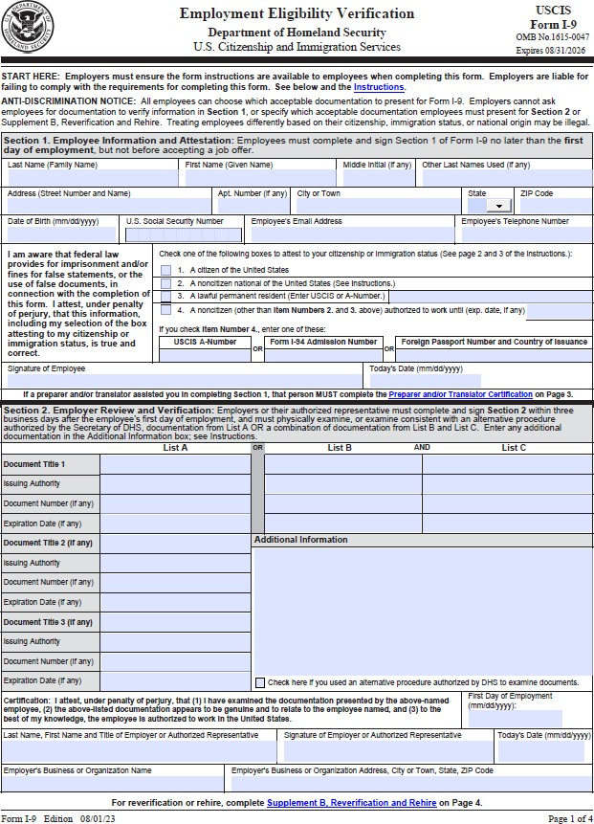
Form I-9 Mechanics

Slide 13
Who can Work in the U.S.
Citizens of the United States
Noncitizen Nationals of the United States
Lawful Permanent Residents
Non-citizen Authorized to Work

Slide 14
Form I-9 Basic Requirements
  Section 1 - completed by employee no later than start date of employment.
  Section 2 - completed by employer by end of third business day after employee starts work.
  May complete form prior to start date if offer of employment is made and accepted.

Slide 15
Discrimination and Unfair Documentary Practices
Employers MUST refrain from discriminating against individuals on the basis of actual or perceived national origin, citizenship or immigration status
Do not require specific documents or combination of documents.
Do not require more or different documents than minimally required.
Do not refuse to accept documents that reasonably appear to be genuine.
Employee’s choice which of the acceptable Form I-9 documents to present.

Slide 16
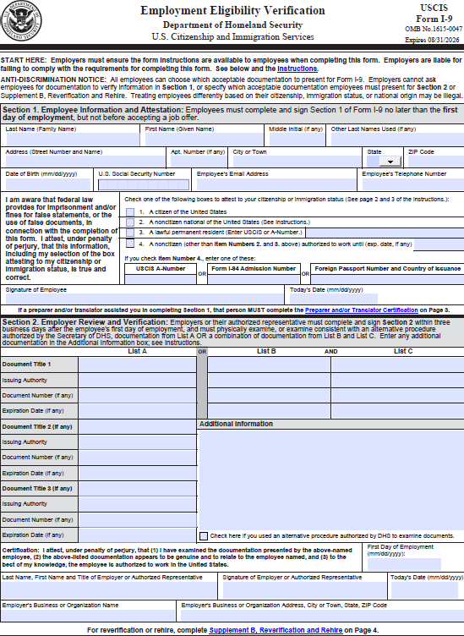
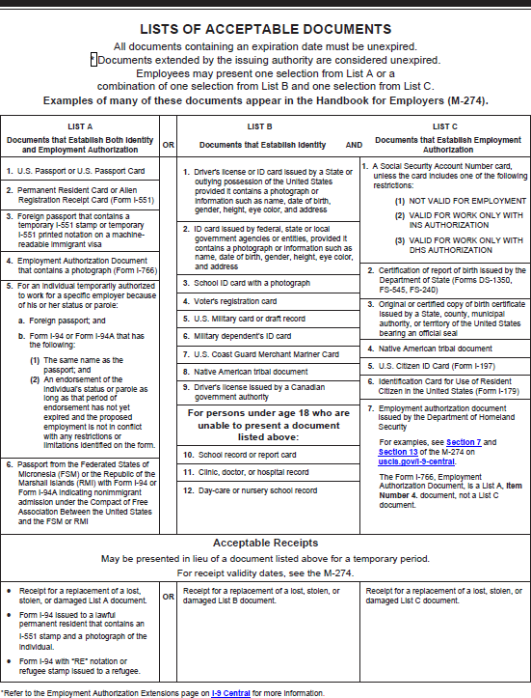
Completing Form I-9
Lists of Acceptable Documents
Form I-9

Slide 17
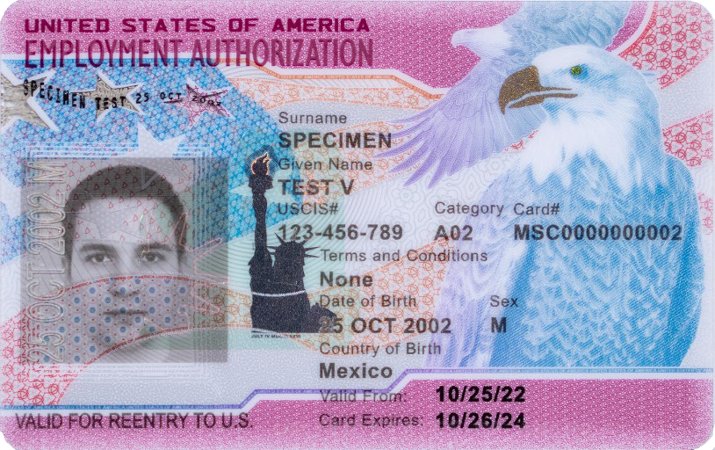
Section 2: Examining Documents
You must accept a document presented by an employee if it reasonably appears to be:
Genuine
AND
Relates to the individual presenting it
The document must be original – photocopies are NOT
acceptable, except for a certified copy of a birth certificate

Slide 18
Section 2: Copying Documents
You may choose to copy and retain the documents employees present for Section 2. If you choose to photocopy documents:
You must do so for ALL employees
Retain only those documents used for I-9
E-Verify employers must photocopy the following documents if voluntarily provided by the employee for Form I-9 Section 2:
U.S. Passport or Passport Card
I-551 Lawful Permanent Resident Card
I-766 Employment Authorization Document

Slide 19
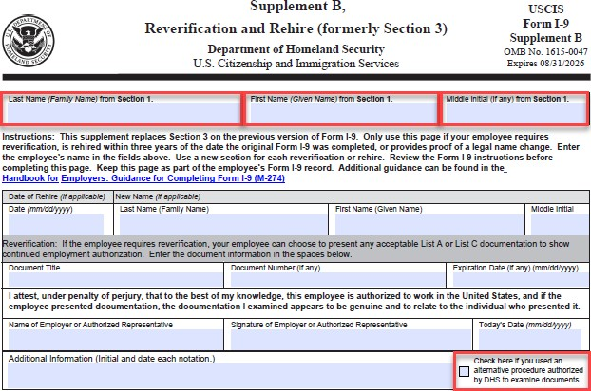
Supplement B: Reverification and Rehires
Employers MUST reverify an employee using Form I-9, Supplement B, if their temporary employment authorization status or temporary employment authorization document has expired
You may also complete Supplement B if you:
  Rehire the employee within 3 years of the original date of employment
  Update the employee’s biographic information
* Do not create a new E-Verify case for an existing employee you are reverifying

Slide 20
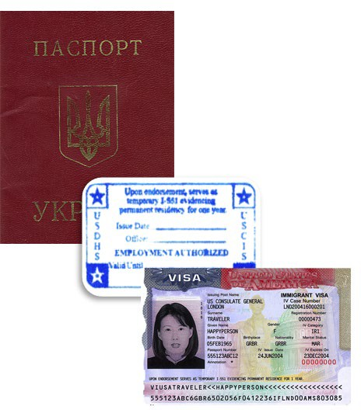
Supplement B: When to Reverify on Form I-9
Reverify | An Employment Authorization Document (Form I-766) with an expiration date Form I-94 with temporary I-551 stamp Unexpired foreign passport with temporary I-551 stamp
Do not Reverify | U.S. citizens and noncitizen nationals U.S. passports or passport cards Unexpired Permanent Resident or Alien Registration Receipt card (Form I-551) Expired Permanent Resident Card presented with Form I-797 List B documents

Slide 21
Correcting Form I-9
Correcting Mistakes
If you discover a mistake on Form I-9, correct the existing form
  Section 1 – Employee makes corrections.
  Section 2 – Employer makes corrections.
Strike a line through errors – do not use White Out or Liquid Paper. Must be transparent. Do NOT backdate.
All corrections should be initialed/name written, dated, and include the words “Per Self Audit” by the internal company I-9 auditor

Slide 22
Storage
You must have a Form I-9 on file for all current employees:
Keep I-9s separate from personnel files
Store Forms I-9 securely in a way that meets your business needs – on site, off-site,
storage facility
If saving electronically, be sure that electronic system complies with USCIS electronic storage requirements
Store copies of documents with the Form I-9
Ensure that only authorized personnel have access to stored Forms I-9
Make sure I-9s are able to be produced within three days of an audit

Slide 23
Retention
Once employee terminated, you must retain I-9 form for:
At least three years from date of hire; or
At least one year from date of termination;
Whichever date is later.
Once retention requirements met, purge form.
Calculate how long to retain an employee’s Form I-9 once they end employment:
If they worked for less than two years, retain their form for three years after the date you entered in the First Day of Employment field.
OR
If they worked for more than two years, retain their form for one more year after the date they stop working for you.
EXAMPLES:
John Smith (Hired Nov. 1, 2019,
terminated May 5, 2020): John worked for less than 2 years, keep his form for 3 years, until 11/01/2022
Betsy Ross (Hired Nov. 1, 2002,
terminated May 5, 2020): Betsy worked for more than 2 years, keep her form for one more year, until 05/05/2021

Slide 24
Automatic EAD Extension
540-day automatic extension. On Dec. 13, 2024, the Department of Homeland Security published a final rule that permanently increases the automatic extension period for employment authorization and Employment Authorization Documents (EAD) available to certain EAD renewal applicants from up to 180 days to up to 540 days.
The final rule became effective on Jan.13, 2025 and applies to certain timely filed renewal EAD applications pending on or filed on or after May 4, 2022.

Slide 25
Compliance Tips for Employers

Slide 26
8 Best Practices for Employers to Maximize Compliance
The Form I-9 remains deceptively simple. Any time a one-page form requires eight pages of instructions, two supplements, a 146-page handbook on how to complete the form, and the potential for significant monetary and criminal penalties, it will continue to present a significant compliance challenge for employers.
Here are eight steps you can take to create a culture of compliance:
Provide updated training for all managers, human resources personnel, and staff involved in the I-9 process;
Provide updated training for all involved in the E-Verify process, including training on fraud awareness and
anti-discrimination;
Update immigration policies in handbooks;
If your company does not have an immigration compliance policy, now is the right time to consider implementing one;
Update internal business processes associated with I-9s and E-Verify;
If your company uses an electronic I-9 provider, contact the provider now to ensure its system incorporates the new changes and complies with DHS requirements, including audit trails;
Enlist outside immigration counsel to conduct an attorney-client privileged audit of your I-9s
Evaluate E-Verify advantages and disadvantages with your immigration counsel to determine if your company should take advantage of the remote verification option for E-Verify employers.

Slide 27
Best Practices When Employees Provide Updated Information
In complying with the new Form I-9 and review requirements, remember that California Labor Code section 1024.6 still applies.
Under California Labor Code section 1024.6, employees have a protected right to update their personal information, including a lawful change of name, Social Security number, or federal employment authorization document.
Specifically, employers cannot fire, discriminate, retaliate or take any adverse action against an employee for updating or attempting to update their personal information.
Examples of prohibited conduct include:
  Suspending an employee who attempts to update her Employment Authorization Document
  Demoting an employee who attempts to provide the employer with her new name.
  Firing an employee who attempts to update her SSN

Slide 28


QUESTIONS?
Rebecca Hause-Schultz
Fisher Phillips
Partner
Rhause-schultz@fisherphillips.com
Bryan Little
FELS and California Farm Bureau
Coo
blittle@CFBF.com

